Slide 1
Big data analytics
5.
2020

Slide 2
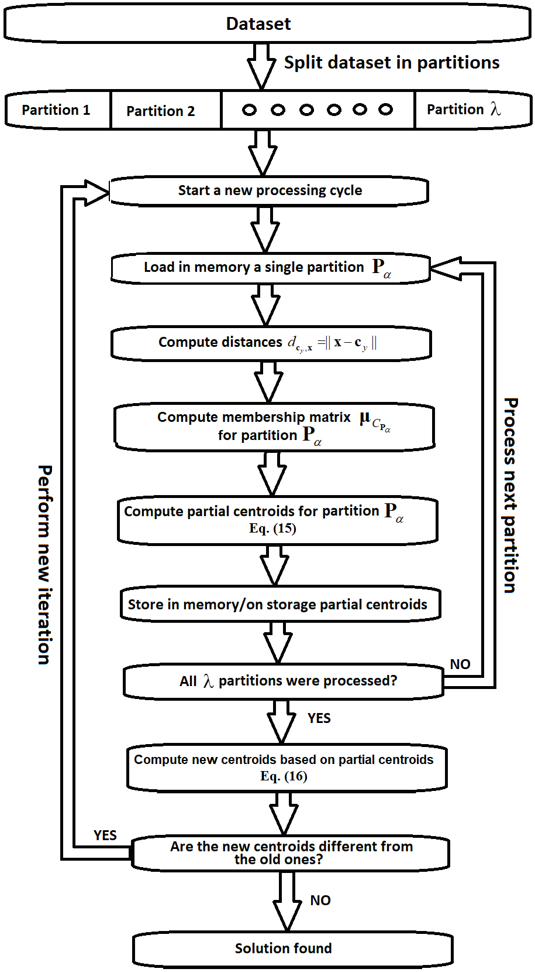
PARTITIONAL IMPLEMENTATION OF KM AND FCM
MapReduce paradigm: https://www.youtube.com/watch?v=bcjSe0xCHbE
Analyze Documents/Partitional implementation.doc

